Slide 1



HoneyMoney
HoneyMoney.app
Happy Wife . Happy Life
The AI money layer for Malaysian Families
MAIC Nexus 2026 | Track T3

Slide 2


HoneyMoney
The Problem
Malaysian households run their money across four or five e-wallets, e.g., TNG, MAE, GrabPay, ShopeePay, plus cards and cash. Nothing adds them up.
Traditional apps answer with manual entry and surveillance, so people burn out and stop.
Tracking fatique is the failure mode, not missing features.
For couples: no shared view of what must be paid, and no private space for what should not be.
Not a data problem, but a decision issue.
Households find out they overspent after the money is gone.
honeymoney.app
Page
02

Slide 3

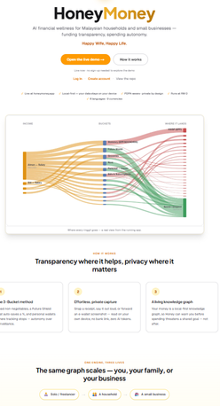
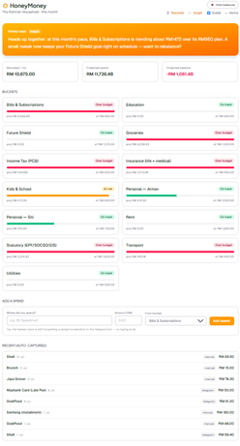
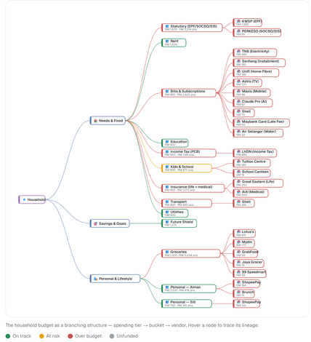
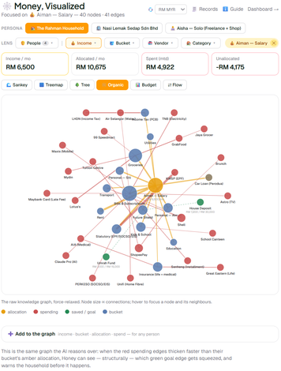
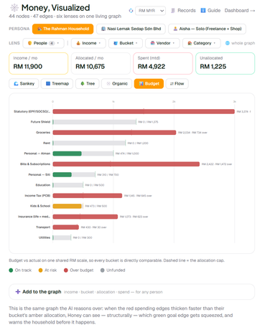
HoneyMoney
Live Now
LIVE NOW, NOT A CONCEPT
Live App
Dashboard
Spending
Analytics
Tracking
Public app live at honeymoney.app,
a real build, no backdated code
Expenditure by day, week, month and with forecast
Add by text, scan a receipt or statement import
Visual analytics on income versus spending
Easy tracking of every expense and record
honeymoney.app
Page
03

Slide 4





HoneyMoney
The 3-Bucket Method
with a Score that Tells You if it Works
Where our money goes
Must‑Paid
Savings
Privacy
Rent, bills, and essentials, shared and visible so both partners know what’s outstanding.
Savings Set as a percentage, moved before it can be spent. Security without willpower.
Personal money stays private by default, with no explanation needed to household members.
How our money works
Health Score
Building, Steady, Strong, and Thriving: a ladder, not a grade, with every point traceable.
Page
04

Slide 5





HoneyMoney
Product
Experience
Easy Capture
Dashboards
Capture spendings through photo-capture, scan receipt, or import statement.
No bank connection required.
Spending by day, week and month, with forward-looking forecast built in.
Add a spend in seconds,
share a screenshot, scan a receipt, photo capture, or import statement.
No bank link.
No forms.
No spreadsheet.
Language & Currency
Sees It Coming
Multiple languages and currencies, so every family member can actually use it, not just the one who set it up.
The forecast doesn't just report. It warns: “Short by the 24th at this pace, RM120 less on dining fixes it.”
honeymoney.app
Page
05

Slide 6

HoneyMoney
Architecture & AI-Support
A USER-FRIENDLY PERSONAL-FINANCE APP, BUILT ON A HOUSEHOLD KNOWLEDGE GRAPH.
LAYER 1
LAYER 2
LAYER 3
LAYER 4
Next.js Progressive Web App Lightweight front end that works on any device.
Nothing to install.
PocketBase knowledge graph Self-hosted and single-tenant.
No analytics SDKs, no data brokers. Credentials encrypted; append-only hash-chained ledger.
On-device capture Screenshots, receipts, CSV statements. OCR runs in the browser, zero AI tokens. Six languages, multi-currency.
Switchable AI
Gemini Flash, Groq, or local Ollama — and any model it hosts, including DeepSeek and Qwen. Cost tracked per call. No vendor lock-in.
A user-friendly personal-finance app, built on a household knowledge graph.
Cost-free AI calls within free-tier limits to start, e.g. Google's $300 credit.
honeymoney.app
Page
06

Slide 7

HoneyMoney
Market & Progress
Market Size:
8.2 million Malaysian households (DOSM, 2024), averaging 1.8 income earners each, so shared-versus-private money is the norm, not a niche. We start with: urban dual-income couples, where the friction is daily.
Gap:
Existing tools sit at one of two extremes: bank apps that see only their own bank, or spreadsheets that see everything but demand discipline nobody sustains.
Where We Sit:
The daily-use of every wallet, with a couple-aware privacy model that a bank-owned app structurally cannot offer.
Progress:
A real, usable honeymoney.app, not a prototype, AI-supported, privacy notice, consent controls, live and working.
honeymoney.app
Page
07

Slide 8



HoneyMoney
Business Model
Strategy & Growth
Revenue
Free for households, forever, 3-bucket tracking, Money Health Score, forecasts.
This is the acquisition engine, not a trial, a user friendly personal budgeting tool.
Budgeting goals and insights, as a service. Employers sponsor seats like health cover; households never pay, premium optional. Employers see trends, never records. Sponsorship and opt-in licensed referrals later.
honeymoney.app
Page
08

Slide 9

HoneyMoney
Development Roadmap
Pilot
Phase 1 (month 0-12 )
Scale
Phase 2 (month 12-24 mth)
Expand
Phase 3 (month 24-36)
1,500 households soft-launch, target 500 seats
Early retention KPIs
National rollout, 15k household, target 8k seats
Revenue from premium tier
ASEAN B2B market, 45k household, target 30k seats
High-value fintech
The Ask
We are raising RM150k to fund 18 months of runway, taking us from a live product with targets below:
500 seats x RM48 = RM24k (1st Yr);
8,000 seats x RM48 = RM384k (2nd Yr);
30,000 seats x RM48 = RM1.44mil. (3rd Yr)
Use of funds: 60% engineering · 25% Employee · 15% Sdn Bhd Incorporation & Expenses.
honeymoney.app
Page
09

Slide 10

HoneyMoney
Drivers & Impact
National Agenda
SDG Alignment
Household financial resilience sits inside the MADANI cost-of-living agenda and Bank Negara's financial literacy priorities. A tool for the behaviour those policies ask for, not a substitute for licensed advice.
SDG 1 (No Poverty), an emergency buffer built by rule, not willpower. SDG 8 (Decent Work), financial stress follows people to work; sponsored seats treat it as a workplace issue.
Privacy as a design rule
Who it reaches
No bank credentials, ever. Receipt scanning runs on-device. Live today: a bilingual PDPA notice, per-purpose consent, and one-click export. Alignment with PDPA 2010, not certified compliance, no audit yet.
Free forever means the households under most cost-of-living pressure are not the ones priced out. Six languages, and a phone-first PWA that installs on hardware families already own.
honeymoney.app
Page
09

Slide 11



HoneyMoney
Our Team - JUST50
Drives business strategy, partnerships, and growth.
Focused on making HoneyMoney.app the go-to expenditure tracking app for Malaysian consumers, couples and families.
Architects the platform, from the local‑first knowledge graph to AI integrations and supporting features, while keeping the system lean and resilient.
AI-award-winning Tech Lead.
Pilot partners: employers and community groups offering HoneyMoney as a wellbeing benefit
Licensed fintech partners for the Year 3 referral layer
Impact-driven investors
Chua Kia Wah
Pong Woon Wei
What We're Looking For
Business Lead | Malaysian Citizen
Tech Lead | Full-Stack & AI Engineer
Contact: hello@honeymoney.app
honeymoney.app
Page
10

Slide 12

HoneyMoney
HoneyMoney.app
Happy Wife . Happy Life
The AI money layer for Malaysian Families
Problems:
Fragmented, messy household money management for consumers, couples, and families.
Overspending gets discovered after the fact.
Solutions:
One app that captures every spend in seconds, scores your monthly money health,
and warns you before you run short, without ever connecting to your bank.
Live now at honeymoney.app!
TRY IT LIVE
Thank you
MAIC Nexus 2026 | Track T3
Contact:
hello@honeymoney.app
Page
11

